Slide 1

Course Name- Production Technology for Ornamental Crops, MAP and Landscaping
Course Code- 20014400
Presented By- Dr. Mahendra Kr. Yadav
B.Sc. (Ag.) IV Sem. (Production Technology for Ornamental Crops, MAP and Landscaping)

Slide 2
Course Objectives
Identify different types of ornamental and medicinal crops.
Examine various principles of landscaping, uses of landscape trees, shrubs and climbers, production technology of important ornamental crops, etc.
Determine about Demonstrate various Package of practices for loose flowers and their transportation, storage house and required condition for cut and loose flower.
Construct about the various problems with the production technology of medicinal and aromatic plants.
Importance of Processing and value addition in ornamental crops and MAPs produce.
B.Sc. (Ag.) IV Sem. (Production Technology for Ornamental Crops, MAP and Landscaping)

Slide 3
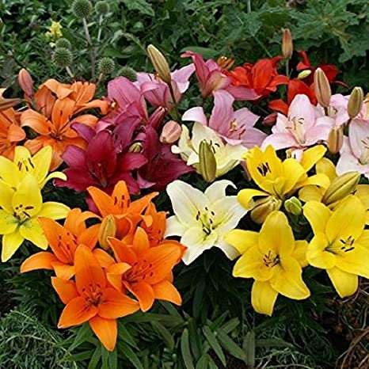
Protected Cultivation of Lilium
B.Sc. (Ag.) IV Sem. (Production Technology for Ornamental Crops, MAP and Landscaping)

Slide 4
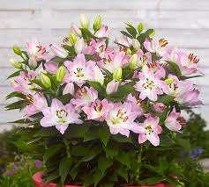
INTRODUCTION
Common name: Lilium
Scientific name:
Madonna lily : Lilium candidum
Easter lily: Lilium longiflorum
Family: Liliaceae
Chromosome Number:
2n : 2x: 24
3n : 3x: 36
B.Sc. (Ag.) IV Sem. (Production Technology for Ornamental Crops, MAP and Landscaping)

Slide 5
Soil and Climate
Well drained soil, rich in organic matter and having pH 6.5-7.5
Growing medium
soil: peat moss:: 1:1
soil: peat moss: perlite:: 1:1:1
Climate
Temperature (Day: 18-25ºC and Night: 12-18ºC)
Partial shade (40-50%)
Good aeration/ ventilation
B.Sc. (Ag.) IV Sem. (Production Technology for Ornamental Crops, MAP and Landscaping)

Slide 6
Propagation & Treatment of Bulbs
Bulbs
Seed
Bulblets
Scales and
Bulbils in L. bulbiferum, L. sargentiae, L. tigrinum and L. wallichianum
Planting time
Low hills: Oct.-Nov.
Mid hills: Feb.-Mar. and July-Sep.
High hills: March-April.
B.Sc. (Ag.) IV Sem. (Production Technology for Ornamental Crops, MAP and Landscaping)

Slide 7
Varieties:
Asiatic hybrids :
Dreamland (yellow), Brunello (orange), Novona (white), Pollyanna (yellow), Yellow Giant (yellow), Vivaldi (pink), Black Out (Deep red)
Oriental hybrids:
Star Gazer (Pink & white), Nerostar, Siberia, Acapulco (cyclamen pink) and Casablanca
Eastern lily (L. longiflorum): Elegant Lady, Ace, Snow Queen, White, American, Croft and Harbor
B.Sc. (Ag.) IV Sem. (Production Technology for Ornamental Crops, MAP and Landscaping)

Slide 8
Planting density and spacing
Planting density and spacing depends upon
group of Lilium
bulb size
place of cultivation
Planting density : 20-40 bulbs/m²
Spacing: 40 cm X 15 cm
20 cm X 15 cm
B.Sc. (Ag.) IV Sem. (Production Technology for Ornamental Crops, MAP and Landscaping)

Slide 9
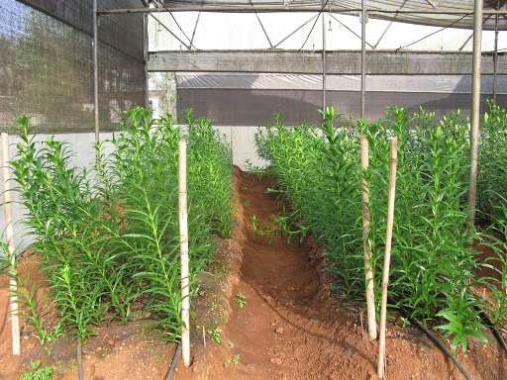
Intercultural operations
Weeding
Three-four hand weedings and herbicides like Propyzamide @ 2.25kg/ha and chloropham 3.5 l/ha are applied as pre-emergence.
Staking in lilium
B.Sc. (Ag.) IV Sem. (Production Technology for Ornamental Crops, MAP and Landscaping)

Slide 10
Nutrient management
NPK:: 30:20:20 g/m2
For liquid feeding of NPK::14:10:14
Fertilizers should not come in direct contact with bulbs as it leads to rotting.
B.Sc. (Ag.) IV Sem. (Production Technology for Ornamental Crops, MAP and Landscaping)

Slide 11
Water management
Soil should have 60-90 per cent moisture and no watering is required until bulbs sprout.
Depending upon weather 8-12 irrigations of 2.5-5 cm depth are required.
B.Sc. (Ag.) IV Sem. (Production Technology for Ornamental Crops, MAP and Landscaping)

Slide 12
Harvesting and Storage of Bulbs
Harvesting Stages
Local market: When 1-2 florets open
Distant market: When 1-2 florets show colour.
Cut stems few centimeter above ground level for increasing bulb size.
Storage of Flowers: 1-2ºC
Harvest bulbs after 40-50 days of flowering or foliage start turning yellow.
Store the bulbs in moist sand at -2º C for initial three weeks and later on at 0-2ºC until two weeks before planting.
Yield
30-40 flower stems/m square
B.Sc. (Ag.) IV Sem. (Production Technology for Ornamental Crops, MAP and Landscaping)

Slide 13
Diseases
Gray mould (Botrytis elliptica, B. cinerea)
Soft bulb rot (Rhizopus stolonifer)
Fusarium bulb rot (Fusarium oxysporum f. lilii)
Brown scale (Colletotrichum lilii)
Root rot (Pythium splendens)
Bacterial soft rot (Pseudomonas spp.)
Viral diseases (mosaic)
B.Sc. (Ag.) IV Sem. (Production Technology for Ornamental Crops, MAP and Landscaping)

Slide 14
Insect and pests
Aphids
Thrips
White flies
Mites
B.Sc. (Ag.) IV Sem. (Production Technology for Ornamental Crops, MAP and Landscaping)

Slide 15
Physiological Disorders
Leaf scorch: It is due to deficiency of Mn, Al which occur at over dose of nitrate level and add lime @ 10 ton/ha.
Bud blast: It is due to storage of water at top of plant, competition for nutrients, fluctuating carbohydrate level, low light intensity and high nitrate level.
Puffy foliage: It is due to frost injury and stunting of
plants.
B.Sc. (Ag.) IV Sem. (Production Technology for Ornamental Crops, MAP and Landscaping)

Slide 16

B.Sc. (Ag.) IV Sem. (Production Technology for Ornamental Crops, MAP and Landscaping)

